Slide 1
Ultrasonic waves

Slide 2
Ultrasonic waves
The frequency range of the waves below 20Hz is
called as infrasonic waves.
The frequency range of the waves between 20Hz to 20KHz is audible range.
The frequency range of the waves above 20KHz is called as Ultrasonic waves or supersonic waves.

Slide 3
Ultrasonic waves
Properties of Ultrasonic waves:
The speed of propagation of ultrasonic waves increases with increase in frequency.
Wavelength of ultrasonic waves is very small so diffraction is negligible.
Ultrasonic waves can travel over a long range with out loss of any energy.

Slide 4
Ultrasonic waves
Difficulties with production of ultrasonic waves:
Generally sound waves are produced by vibrating surfaces so it is difficult to produced high frequency sound waves, because inertia will never allow any surface to vibrate at such a high frequency.
Inertia is resistance of any physical object to a change in it’s state of motion.
OR
The tendency of an object to resist any change in
it’s motion

Slide 5
Ultrasonic waves
Mainly two methods are used to produced ultrasonic waves.
Magnetostriction effect
Piezoelectric effect

Slide 6
Magnetostriction effect
When a rod of ferromagnetic material is placed in a steady magnetic field parallel to it’s length, then rod undergoes a small change in length. This phenomenon is called as Magnetostriction effect.
The change in length is independent of the direction of applied magnetic field.
The change in length is found to proportional to the intensity of magnetization, when the magnetic field is well above the magnetic saturation.
The change in length is also depends on the nature of material.

Slide 7
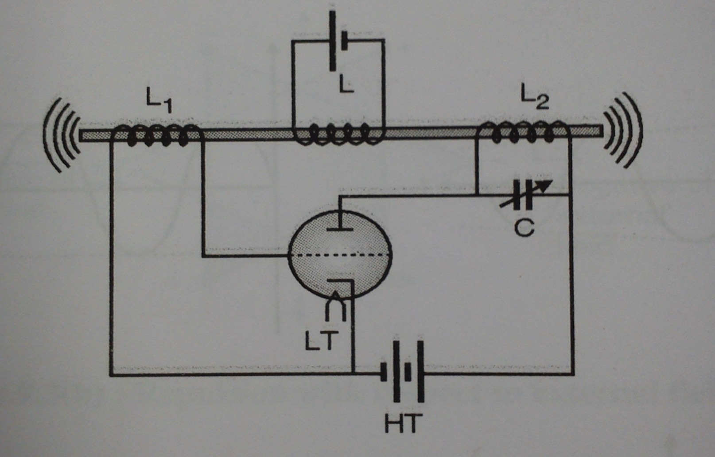
Magnetostriction Oscillator
Principle:
When natural frequency of ferromagnetic material is
equal to the frequency of magnetostriction oscillator
then resonance will obtained

Slide 8
Working
As the circuit is switched on the plate current start flowing through coil L2 producing a magnetic field B along the axis of the rod .
Now the rod is placed in a magnetic field along its length, as a result of which its overall length will change by a small amount.
As the length changes the flux linked with L1 and L2 also changes which results an induced emf,
across L1.
The induced emf is fed to grid and grid voltage will change which caused change in plate current
Due to alternating current flowing through coil L2, the magnetic field becomes an alternating magnetic field giving rise to the vibrations of the rod

Slide 9
The frequency of mechanical vibration of the rod is given by,
where, L = length of rod.
Y = Young’s modulus of the material of the rod.
ρ = density of the material of the rod.
The frequency of oscillator is given by,
By varying the capacitance C of the variable capacitor the oscillator frequency, f_{rod}= f_{oscillator.} and resonance takes place.
At resonance the rod vibrates emitting ultrasonic waves from both its ends.

Slide 10
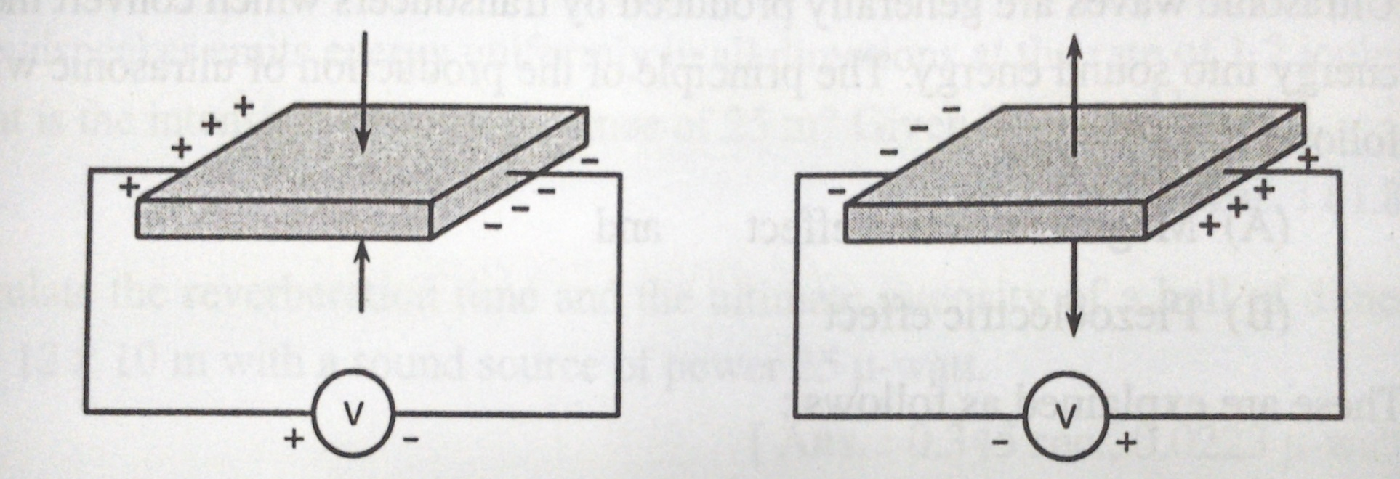
Piezoelectric effect
A thin slices of piezoelectric crystals develop a potential difference across the two opposite faces when subjected to a mechanical stress in a perpendicular direction. This is known as piezoelectric effect.

Slide 11
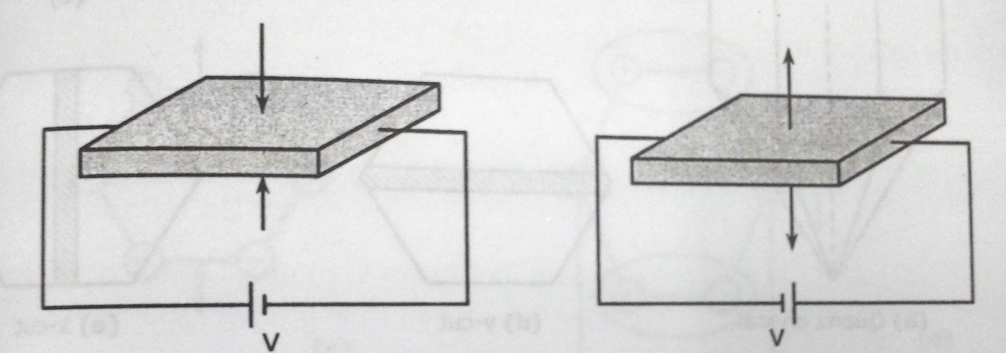
Inverse Piezoelectric effect
If a voltage is applied across a pair of opposite faces of a piezoelectric crystal it experiences mechanical stress
If the polarity of the applied voltage is reversed the nature of the mechanical stress is also reversed.

Slide 12
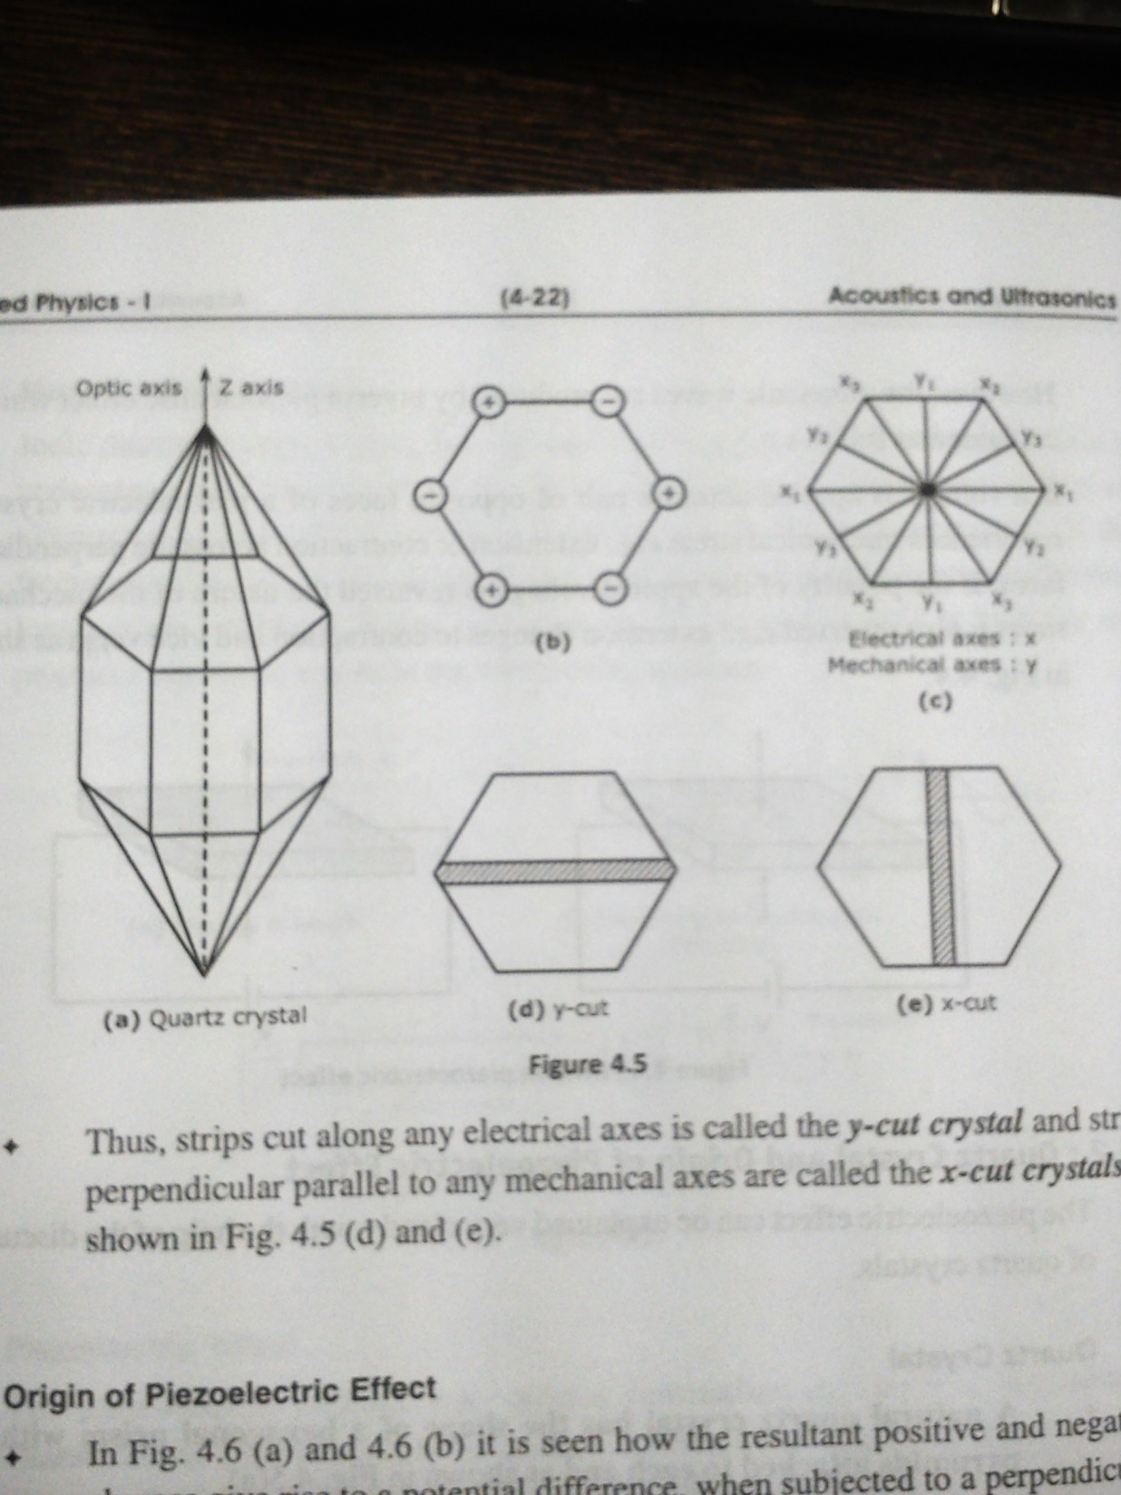
Quartz Crystal

Slide 13
Quartz Crystal
A natural quartz crystal has the shape of a hexagonal prism with two pyramids attached to each end
The line joining the end points of the pyramids is called the Optic axis or z-axis.
The line joining opposite corner of a cross section is called electrical axis or X-axis.
The line joining mid point of opposite sides of a cross section is called Mechanical axis or Y-axis.
If the voltage is applied across the electrical axis, a mechanical stress will be produced across the mechanical axis or Y-axis

Slide 14
Quartz Crystal
The strips cut along electrical axis is called as y-cut crystal or y-cut plate.
The strips cut along mechanical axis is called as x-cut crystal or x-cut plate.

Slide 15
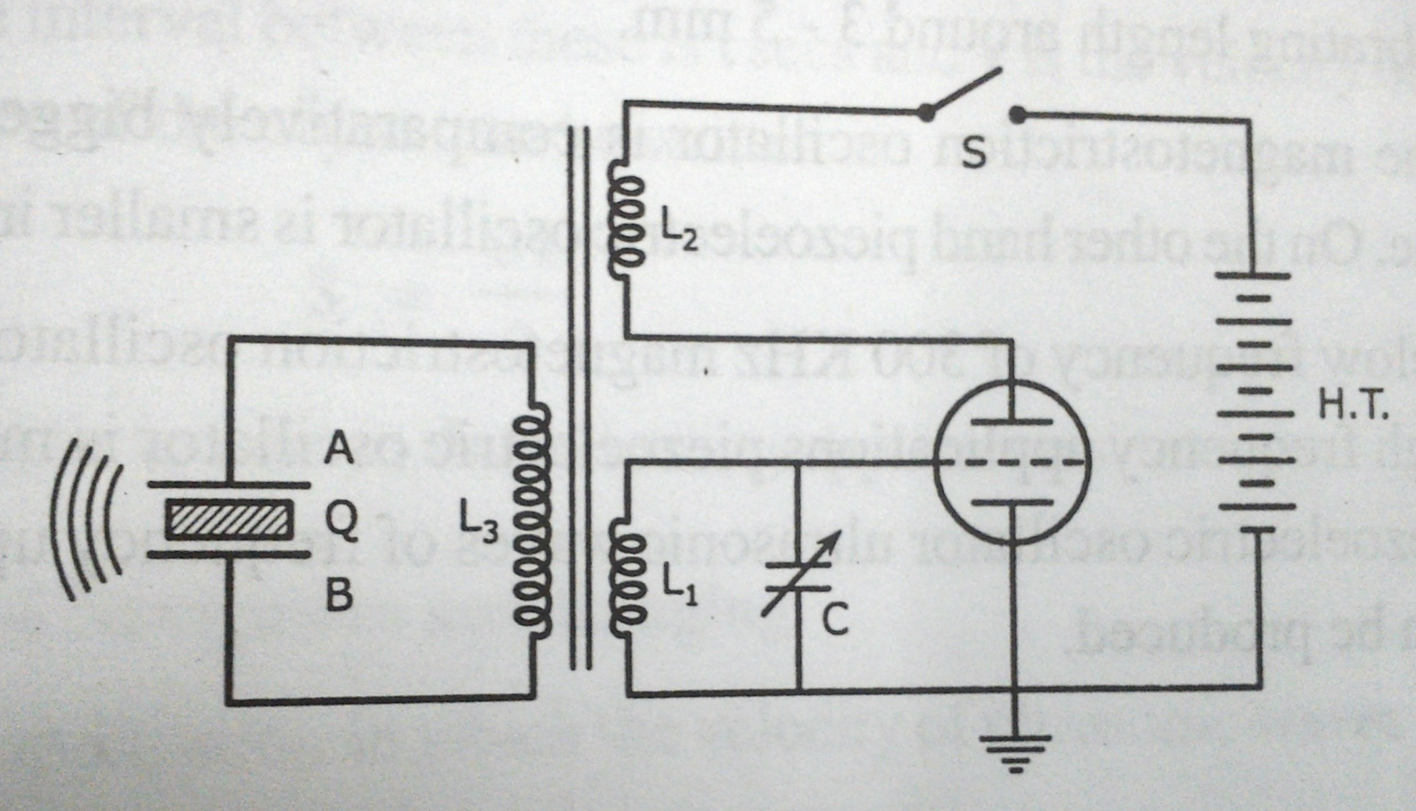
Piezoelectric Oscillator

Slide 16
Piezoelectric Oscillator
A thin slice of quartz crystal ‘Q’ is placed in between two electrodes a and b which are connected to the coil L₃.
The coil L1 and L2 are connected to the plate-cathode and grid-cathode circuits respectively.
The coil L1, L2 and L3 are inductively coupled.
As the switch S is closed the triode valve oscillator produces oscillations of the frequency,

Slide 17
Piezoelectric Oscillator
By transformer action an alternating emf is produced in the secondary coil L3. The emf excites the crystal into the vibrations.
The frequency of mechanical vibrations of the crystal is given by,
Where, t = thickness of crystal.
Y = Young’s modulus of the crystal.
ρ = density of the material of the crystal.

Slide 18
Piezoelectric Oscillator
by adjusting the capacitance of the capacitor C the crystal is set into the resonance when,
f_{crystal}= f_{oscillator.}
and crystal vibrates with high frequency producing
ultrasonic waves of frequency above 100kHz from
its both sides.

Slide 19
Comparison between Magnetostriction and Piezoelectric Oscillator
Sr. no | Magnetostriction Oscillator | Piezoelectric Oscillator
1. | Large power handling capacity | Low power handling capacity
2. | Fit foe smaller frequency | Fit foe higher frequency
3. | Large in size | Small in size
4. | Ferromagnetic material is used | Quartz crystal is used

Slide 20
Applications
Echo sounding
A set of transmitter and a receiver of ultrasonic
waves are used. The transmitter contains a
piezoelectric oscillator from which an ultrasonic
waves is sent through a medium in a particular
direction and wave reflected from object is
collected by the transmitter.
if time interval is ‘t’ and ‘v’ is velocity, then
distance of the object can be written as

Slide 21
SONAR – Sound navigation and Ranging
This is a marine application in which the velocity
of ultrasonic waves in sea water is given by
Where, S=Salinity of sea water and,
t= Temperature of sea water in ⁰C.
Thickness measurement
In metal industry generally to measure the thickness
of plates , ultrasonic waves are used

Slide 22
Non destructive testing
Big concrete slabs, big metal castings like guarders
can easily be tested for cracks, cavities by using
ultrasonic waves
When ultrasonic waves are passed through a
flawless metal it should go to the bottom of the
block from where it is reflected back
If there is flaw , the ultrasonic waves get reflected
from the flaw due to change in medium

Slide 23
Cavitation
Liquid contain microscopic bubbles. Ultrasonic
waves propagate longitudinally through liquids.
The molecules of the medium move back and
forth in the direction of propagation of the wave.
This movement induces alternate regions of
compression and rarefaction. A decrease in
pressure at the area of rarefaction causes local
boiling of the liquid. This causes an intense
evaporation in the bubbles and bubbles grow in
size.

Slide 24
The growth of the bubbles leads to their collapse
within a very short span of one millisecond.
The collapse of bubbles results into a large
number of shockwaves due to which the local
temperature increases.
The shockwaves develop high crushing power of
liquid due to which cavitation effect has
application like,
Ultrasonic cleaning
Alloy formation

Slide 25
Industrial Application
Drilling: Ultrasonic waves are used to drill fine
holes in hard materials like glass and diamond.
Welding: It is the process of joining metals which
can be done by using ultrasonic waves
Soldering: Ultrasonic waves are extremely
effective in soldering aluminum which can not be
done by ordinary techniques.
Medical Application
Ultra sonography
Ultrasonic imaging
Dental cutting

